Slide 1

Maths
How it works for Year 5

Slide 2
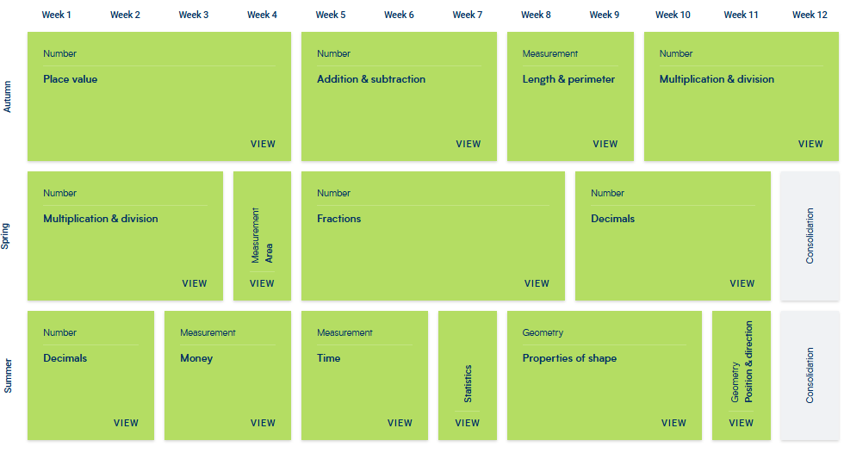
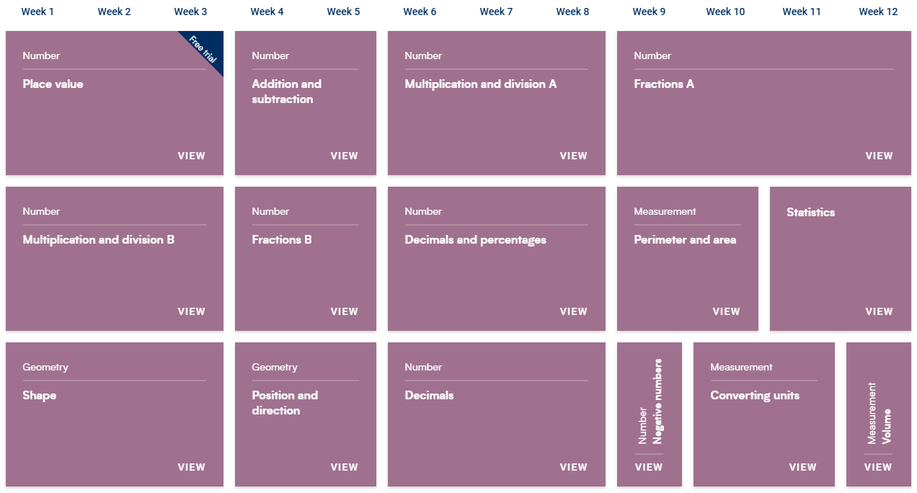
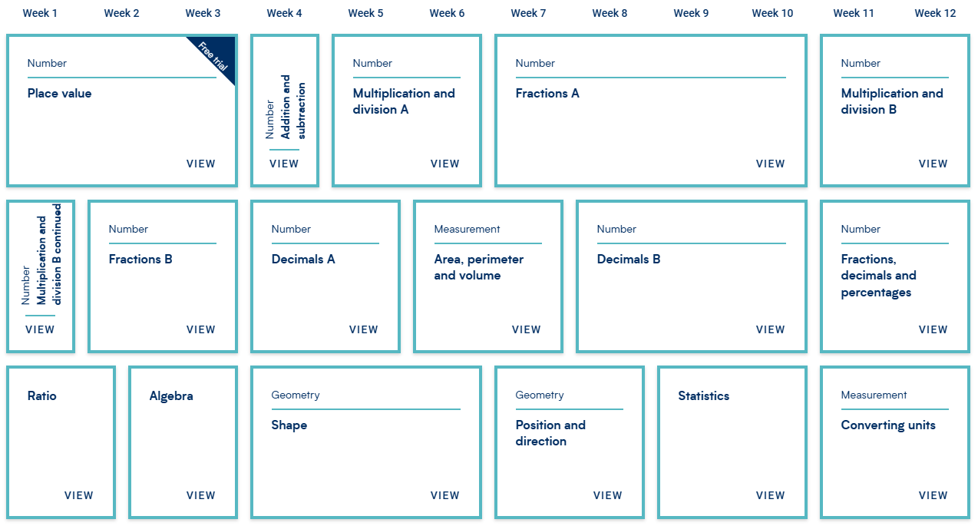

Slide 5
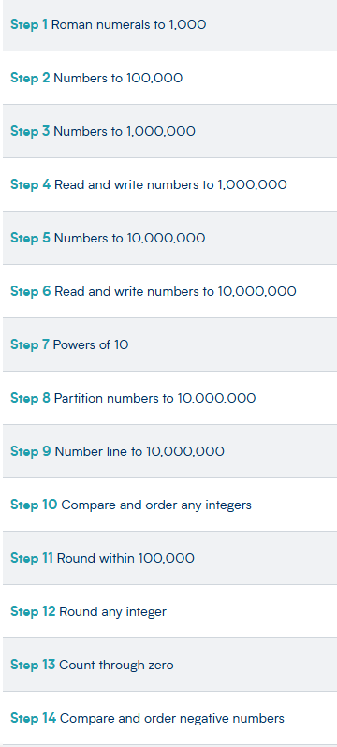
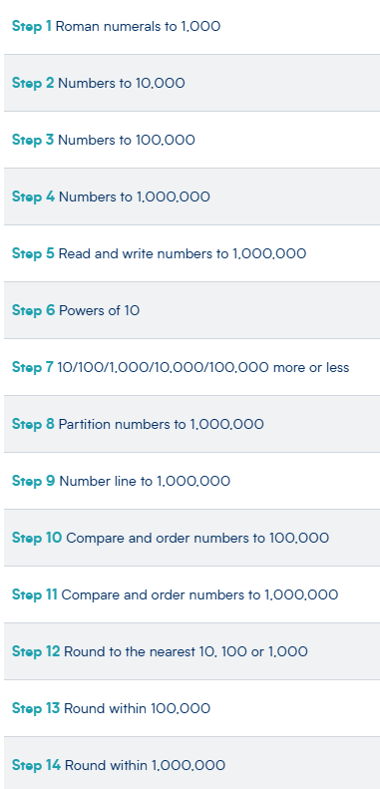
Year 5/6 class
Year 4/5 class

Slide 6
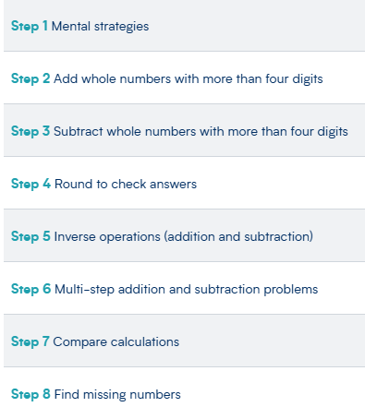
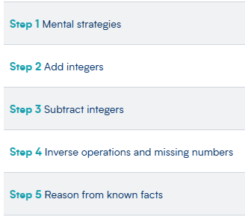
Year 5/6 class
Year 4/5 class

Slide 7
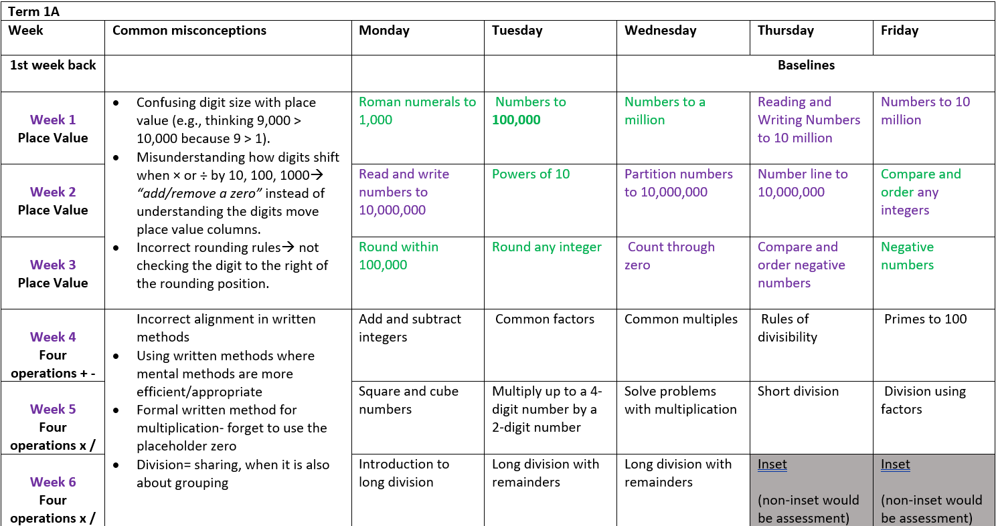
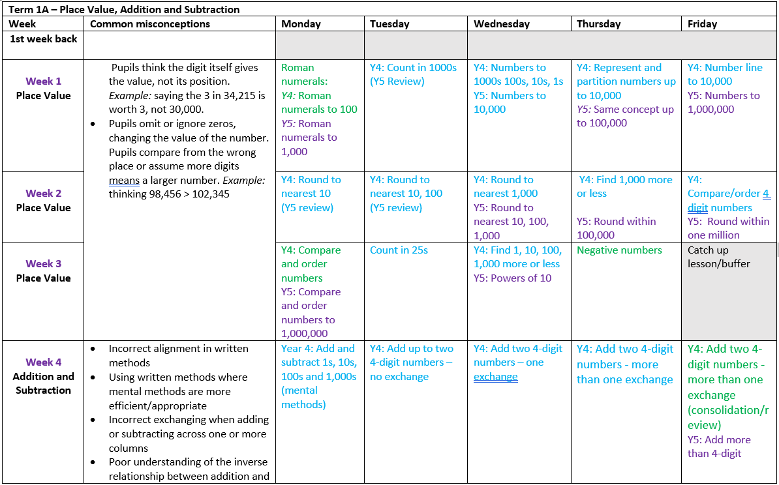
Mixed 5/6 LTP
Mixed 4/5 LTP

Slide 8
Multiplication and division B
Number
Decimals
Fractions A
Perimeter and area

