Slide 1


Life Skills Primary Programme.
Welcome!
Notes:
Trainer notes – link info from specific teacher briefing to this parent briefing IE –
Are work books going home,
Lesson 5 being different lesson content discussed and agreed with teachers,
Graduation date agreed and parents/carers/relatives can attend,
Any other lesson content discussion with teachers of note worth incorporating.
Also, if you have access to student materials whilst conducting this briefing, it is worth letting attendees have a look thru the book?

Slide 2
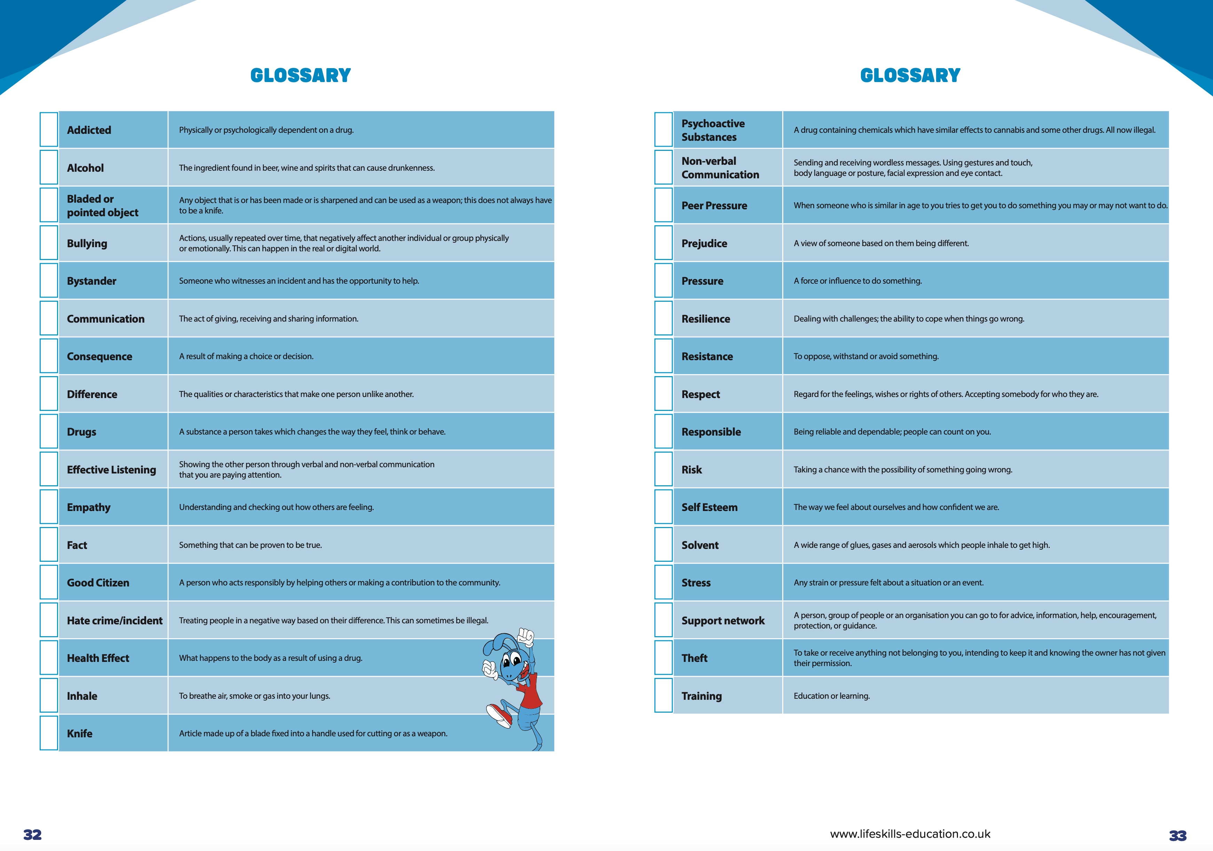
Introduction
Drug, Alcohol and Resilience Training – DAaRT
Designed to get students to consider risky situations, and get them to make informed, safe and responsible choices.
Lots of topics covered!
Notes:
*Trainer note – mention glossary pages 32 and 33, and also contents page at front of student workbook. If trainer has access to schools allocation of student workbooks, consider letting attendees browse thru these whilst delivering this presentation.

Slide 3
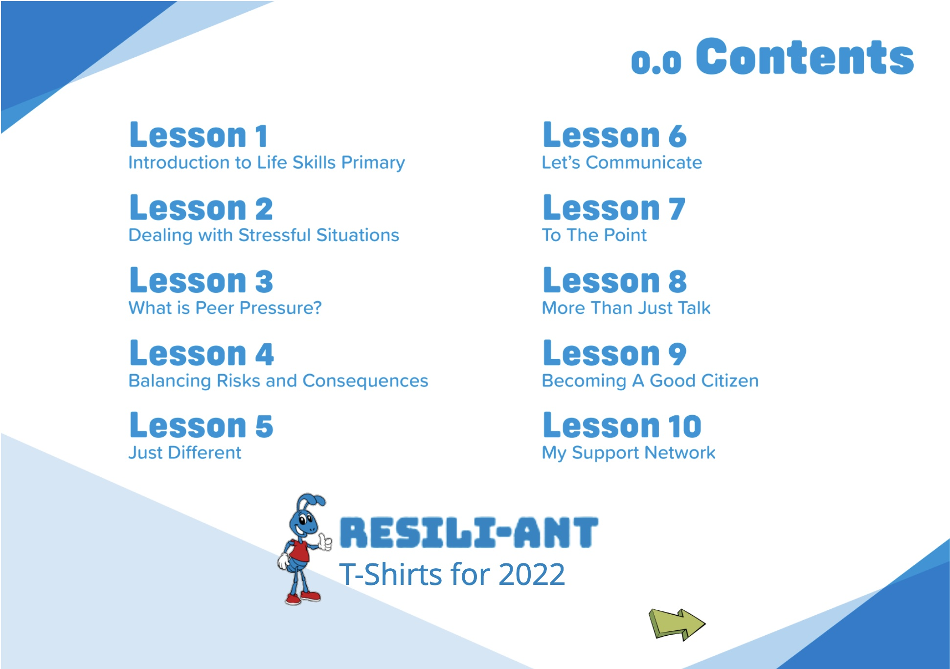
10 sessions plus a graduation…
Notes:
*Trainer note – field any questions re specific lesson content here – be guided on previous notes plus teacher Information.

Slide 4

Student workbooks
Will be asking school to send electronic copy of page 1 to you to sign.

Slide 5
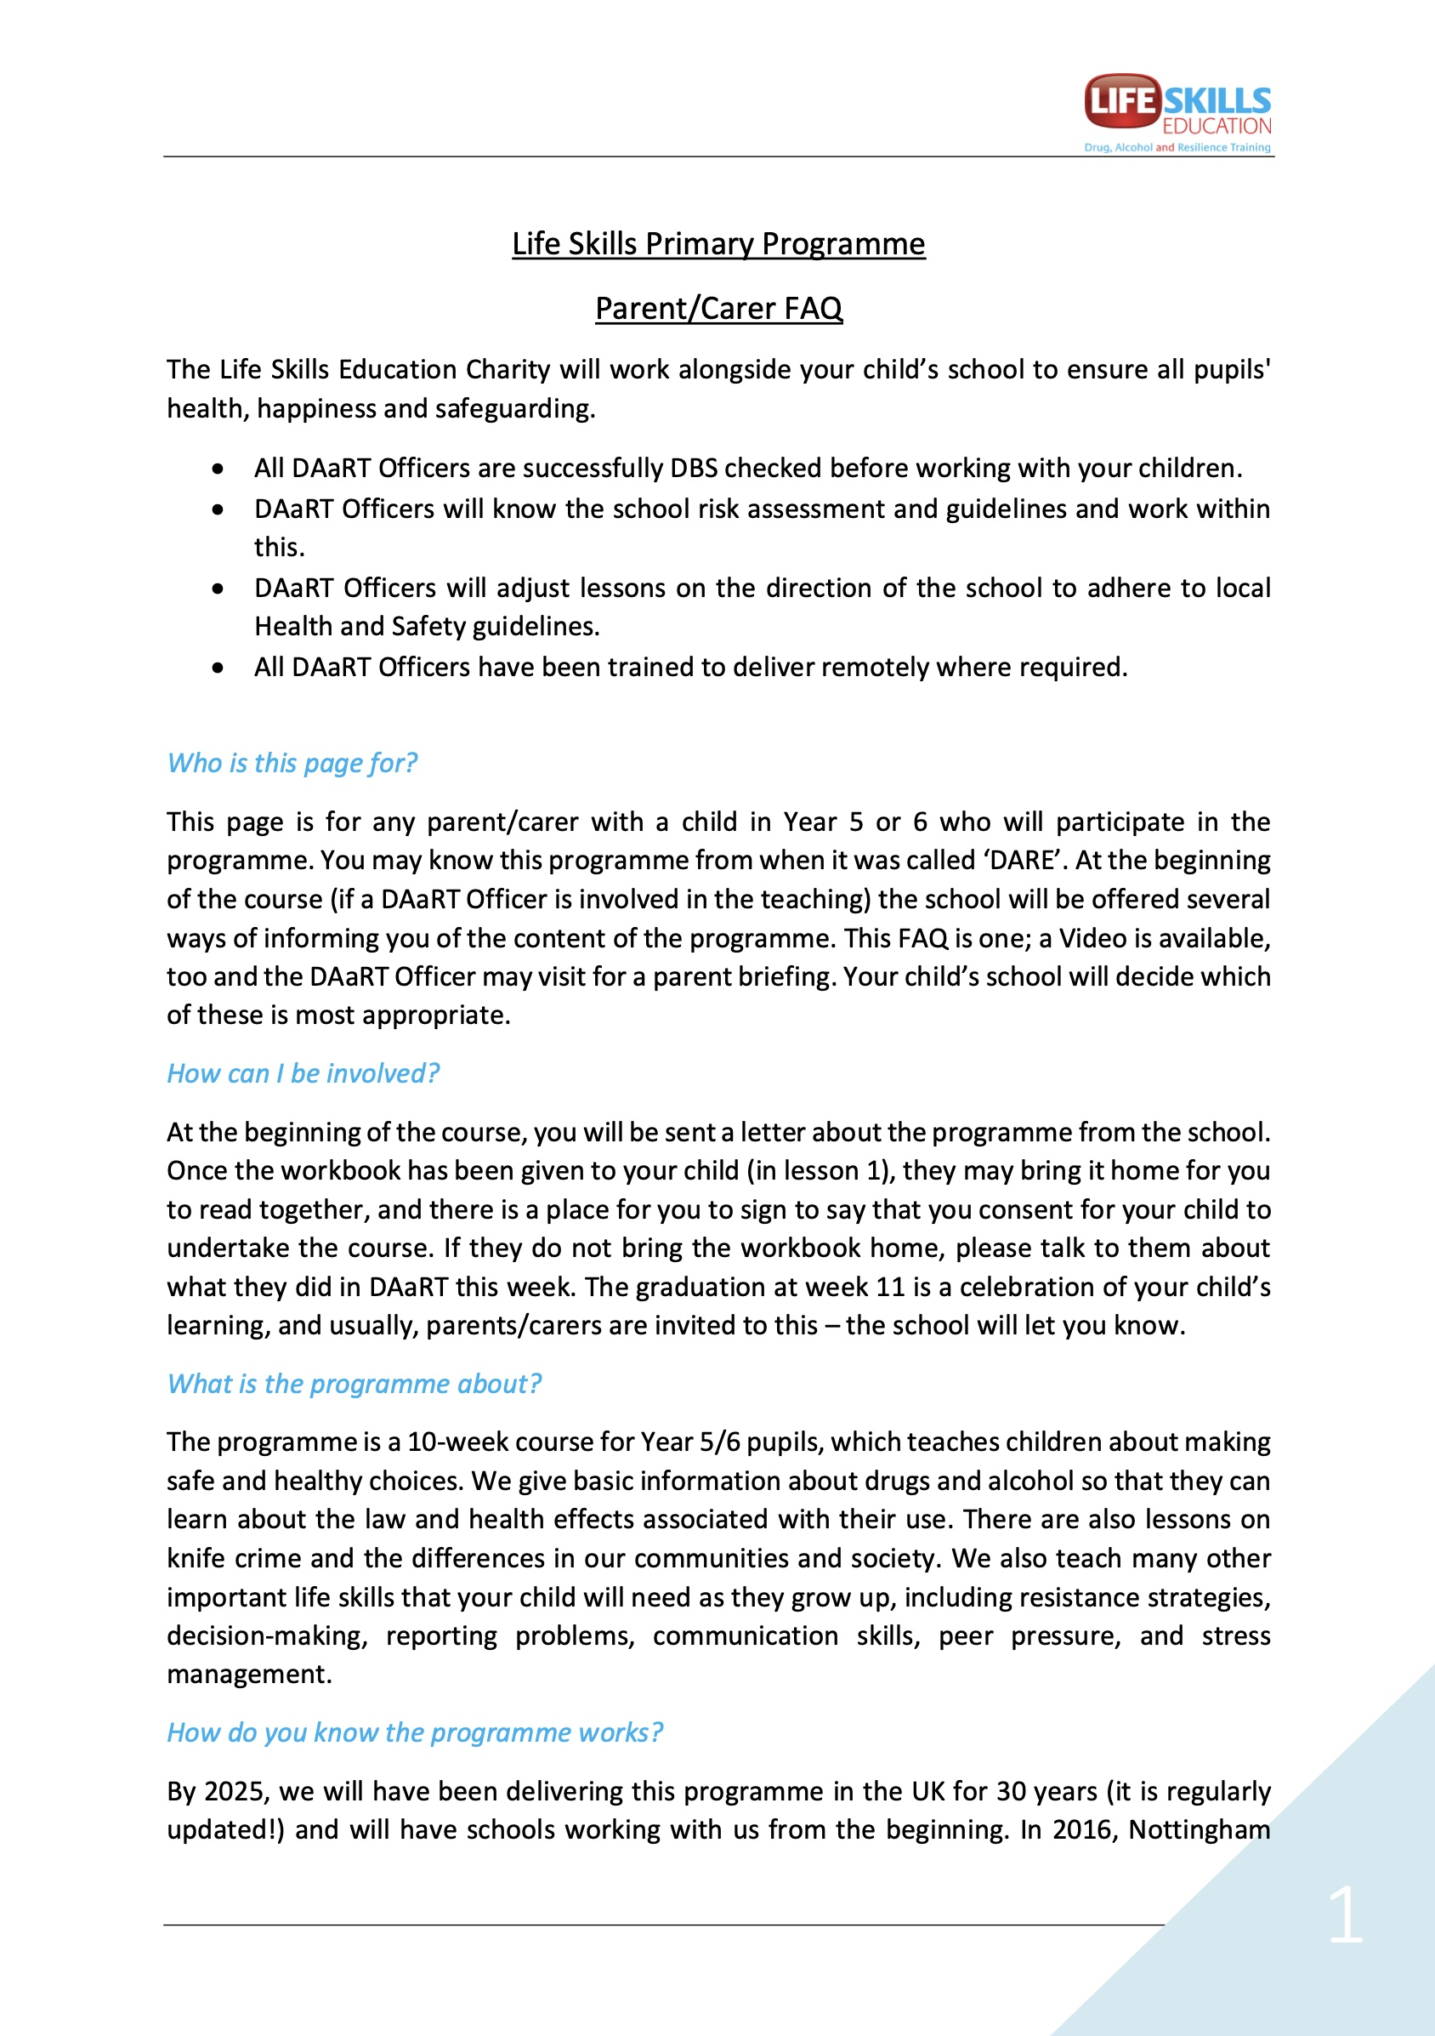
Additional information…
Parent/carer FAQ will be sent out after this session,
YouTube video link also available - contains similar info to this presentation.
Notes:
Remember to supply teachers with this FAQ, plus the link to the parent/carer briefing video so they can send both on after this event.

Slide 6
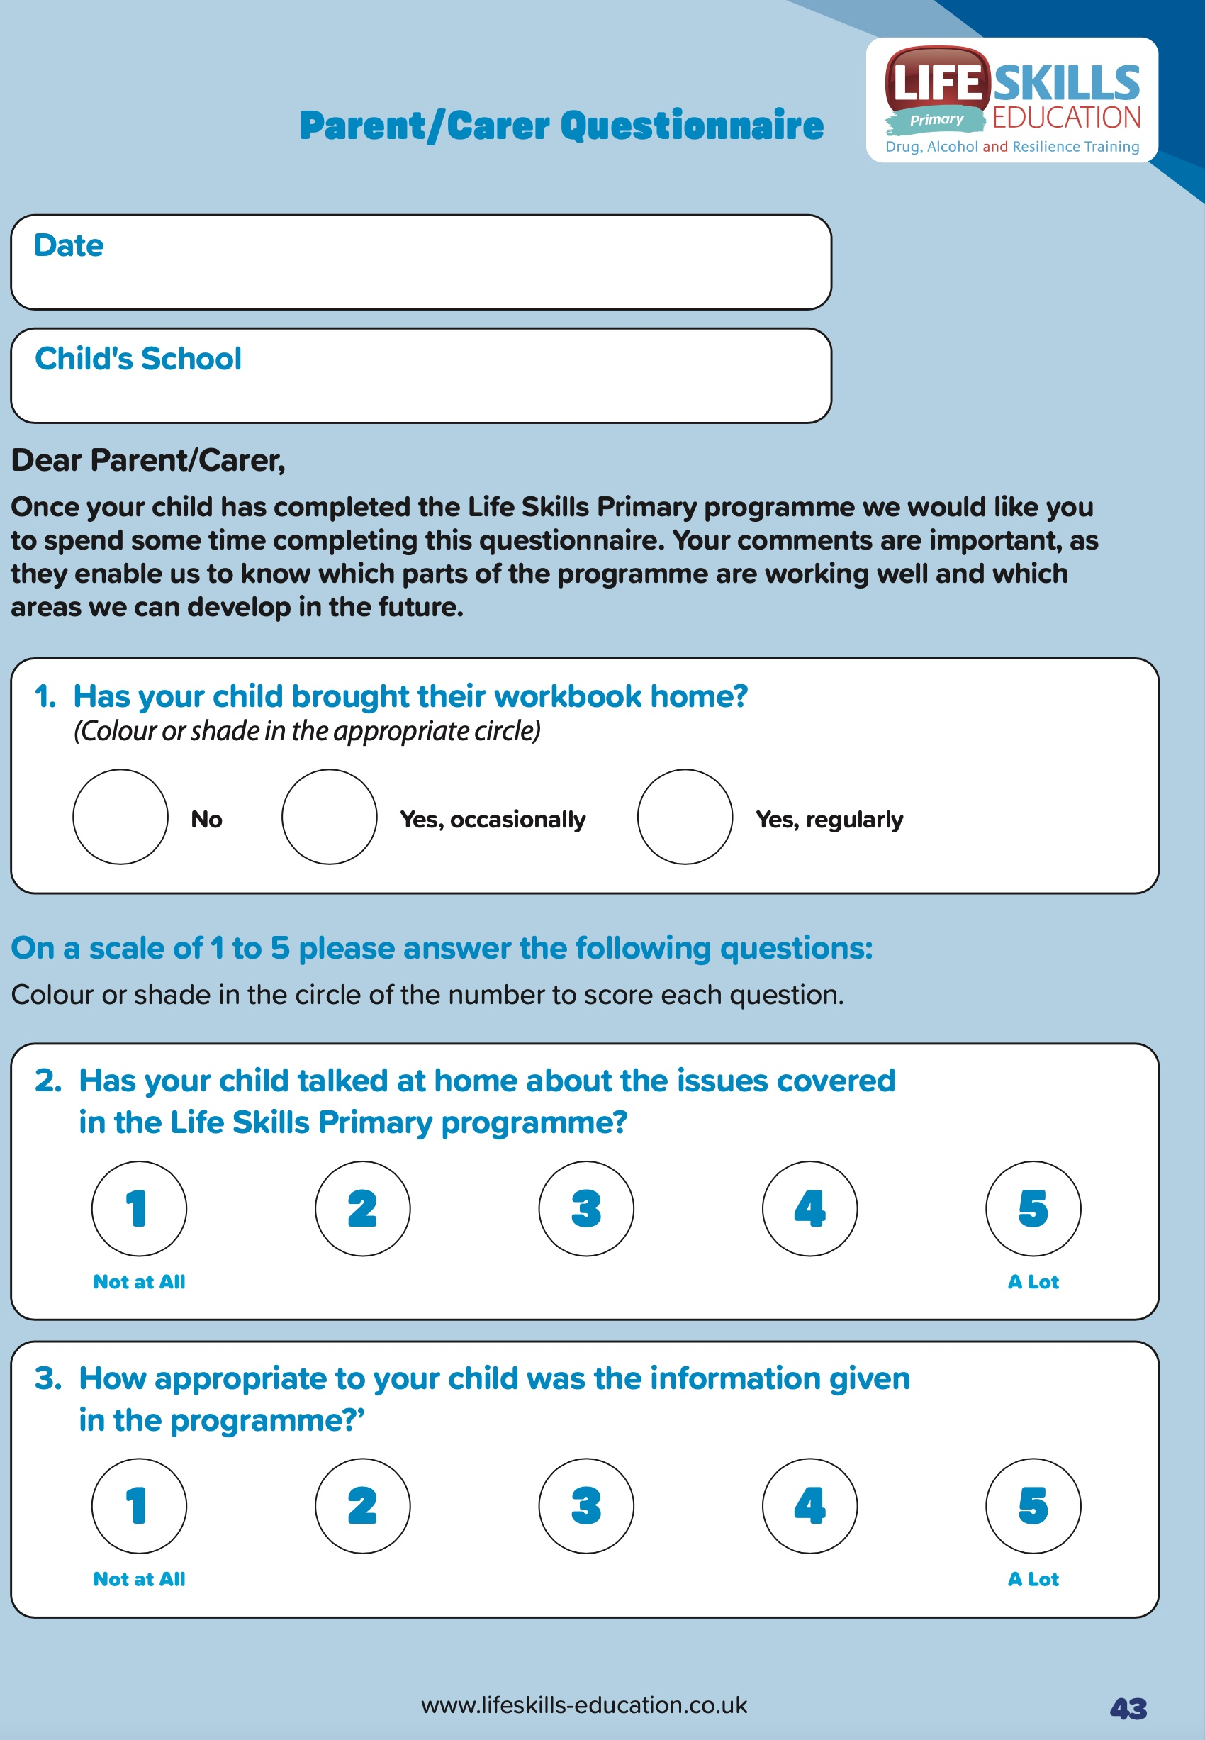
How else can you help and join in?
Don’t forget – the graduation!
A chance for students completing the programme to share what they have learned.
Parent/carer feedback questionnaire – please complete this! Really helps us evaluate and further develop the program.

Slide 7
For more information, please contact us;
https://lifeskillseducation.co.uk
https://www.facebook.com/LifeSkillsEducation
https://www.instagram.com/lifeskillsct/
https://twitter.com/LifeskillsCt
Tel. 0300 111 3273

Slide 8

Thank you for coming!

