Slide 1
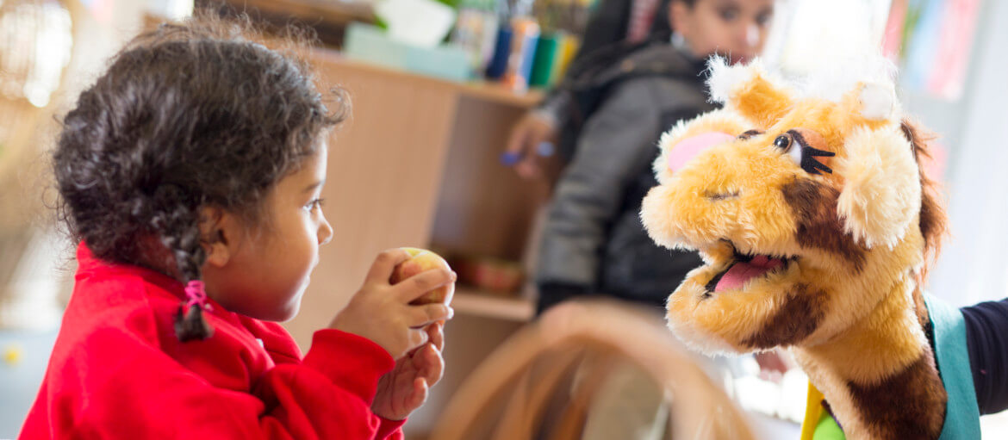



Slide 2

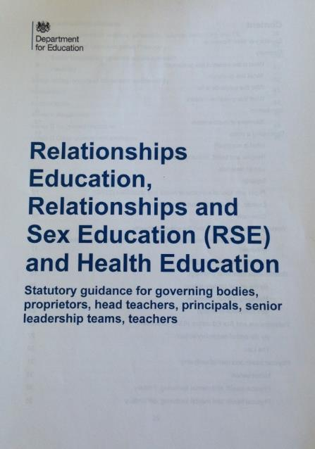
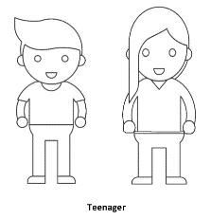
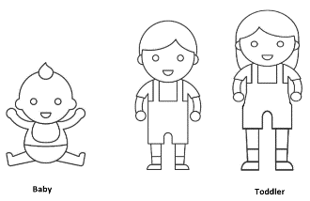
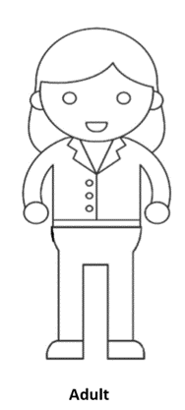
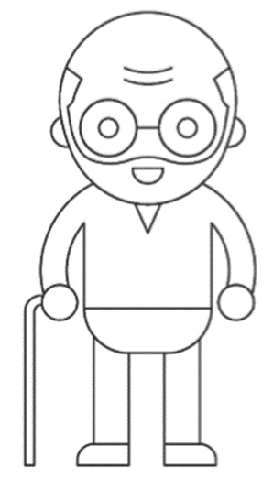
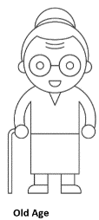

Why we’re here!
Notes:
New guidance has come out. Does anyone know how old the previous guidance was?
2000- 20 years ago!

Slide 3

“This compulsory subject has been introduced to help to keep children safe;
prepare them for the world in which they are growing up, including the laws as they relate to relationships, sex and health;
to help foster respect for others and for difference.”
Damian Hinds – Secretary of State for Education
February 25th 2019
Harriet Gill
Notes:
Remind ourselves of the reasons why the RSE and Health Ed has become statutory.
1st March 2017 that the then Ed Sec, Justine Greening, announced changes to statutory status of RSE
Children and Social Work Act, March 2017
The guidance needs to relate to the modern world, making sure that children and young people are taught how to navigate the modern world safely both on and offline. About keeping children safe and acknowledging that the world has changed dramatically since we were children.

Slide 4

The guidance states:
Schools to start teaching RSE/RE in September 2020, with schools encouraged to begin teaching earlier
All primary schools in England teaching ‘Relationships Education’
All secondary schools teaching ‘Relationships and Sex Education’
Notes:
Statutory status from September 2020.
Relationships Education is statutory in primary schools and the DfE strongly encourages them to continue teaching age appropriate sex education.

Slide 5
Retaining the parental right of withdrawal from sex education, with new rights for children to ‘opt-in’ as they approach age 16
Flexibility for schools in their approach, including for faith schools to teach within the tenets of their faith
Notes:
Parents withdrawal:
Secondary- In RSE parents have right to request child is withdrawn from some or all of sex education delivered as part of RSE. Guidance states good practice involves head teacher discussing the request with the parent and the child (if appropriate), and to discuss the benefits of receiving RSE and any detrimental affects that withdrawal might have. Once discussion have taken place, school should respect parents request to withdraw up to and until three terms before the child turns 16. At that point the child can chose to opt-in.
Primary schools- Head teachers will automatically grant a request to withdraw a pupil from any sex education delivered in primary schools, other that as part of the NC science curriculum. However it is best practice to invite parents who are considering withdrawing their child to discuss their concerns and allay their fears, in case a withdrawal is being made on untruths about what is being taught.
Academies and free schools aren’t required by law to follow the National Curriculum, and so may not follow these programmes of study. However, they do have to teach a broad and balanced curriculum that includes science. And they do have to teach Health Education from September.
Faith schools must teach Relationships and Health Education. They also have the flexibility to use additional resources to support the delivery of relationships which discusses in more detail their beliefs in regards to relationships and family life, e.g. a couple should be married before having children.
Where RSE provision is outstanding the school has generally embraced the natural fit between the core values that run throughout RSE, which revolve around love, care and respect, and the ethos of their school, which tends to be the same. What mustn’t be allowed to happen is for schools to exclude particular topics or information because of the faith or beliefs of parents, or the religious status of the school. Need to be clear what is an opinion and what is fact. (quote taken from Sex Education Forum)

Slide 6
DAaRT also covers a range of issues about keeping safe and looking after our bodies, making healthy choices and forming and understanding positive relationships eg- peer pressure, self-esteem, taking risks and consequences of those risks. So ties in extremely well.
Children are at different stages of knowledge so I will treat sensitively and pitch at appropriate level for the class as a whole.
Be aware questions may be asked at home.
We will discuss ground rules for our sessions.

Slide 7
What does the guidance say about parents?
Parents (and carers) are the prime educators for children on …these matters. Schools complement and reinforce this role…building on what pupils learn at home...
Parents have the right to request that their child be withdrawn from some or all of sex education that primary schools to deliver
Notes:
Once schools have developed their RSE policy it is important that they share it with parents and make it accessible via their website. Involving parents in the process of reviewing the policy ensures they understand how Relationships (and Sex) Education will be delivered in your school.

Slide 8



Relationships Education will focus on:
Families and people who care for me
Caring friendships
Respectful relationships
Online relationships
Being safe
Notes:
This shows the Relationships Education Units.
The focus in primary schools will be on healthy, respectful relationships, concentrating on family and friendships, on and offline.
The proposed new curriculum will cover issues such as talking about emotions, online safety, body image, consent and harassment (in an age-appropriate way), stereotypes, respect and self-respect, tolerance and trust. A summary of each topic:
Families and people who care for me: acknowledging that families are important and provide love, security and stability, what a healthy family life looks like, that sometimes families look different, that these differences should be respected and that these families also provide care and love, and being able to recognise if a family relationship is making them feel unhappy or unsafe and who to talk to.
Caring Friendships: how important friendships are, how to choose and make friends, the characteristics of friendships, that most friendships have ups and downs and how to manage this, how to recognise who to trust and not to, and if a friendship is making them feel unhappy or sad, who to talk to.
Respectful relationships: importance of respecting others even when they are different from us and having self respect, learning about different types of bullying and the responsibilities of bystanders, knowing about stereotypes and permission seeking.
Online relationships: sometimes people behave differently online, need to behave respectfully online as you do offline, keeping safe and reporting harmful content, critically consider online friendships and sources of information.
Being safe: different types of boundaries between friendships, peers and others, concept of privacy, differences between appropriate and inappropriate touch or unsafe contact, how to respond safely and appropriately to adults, how to recognise and report unsafe or feeling bad about an adult, how to report concerns or abuse and the vocabulary and confidence to do so, where to get advice.
Schools are free to determine how to deliver the content set out in the guidance, but suggest effective teaching involves breaking down units into a manageable size in a carefully sequenced way…a bit like our suggested half termly units!
Image taken from https://pixabay.com/illustrations/family-church-cross-faith-religion-5344669/

Slide 9
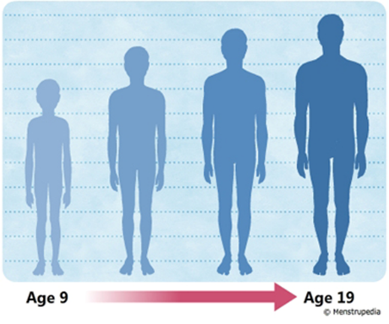
Relationships and Sex Education can also be found in the following Health Education units:
Mental Wellbeing
Internet Safety and harms
Health and prevention
Changing adolescent body
Notes:
Health Education compulsory in all state funded schools but NOT independent schools.
In the guidance the Health Education curriculum covers a number of outcomes related to and reinforcing Relationships Education, including:
Emotions and feelings, simple self care techniques, seeking support from a trusted adult, bullying including cyberbullying, and respectful online behaviour, as well as puberty.
Mental wellbeing- very much related to feelings- helps children work out if something feels right or not. Related to safeguarding.
Internet Safety and Harms- reinforces and supports work delivered regarding online relationships
Health and Prevention-Personal hygiene and germs including bacteria, viruses, how they are spread and the importance of hand washing (remembering this is a spiral curriculum so this lays the foundations to young people learning about Sexually Transmitted Infections in Secondary school).
Changing adolescent body-
The guidance states that:
“Puberty should be covered in Health Education and should be addressed before the onset so, as far as possible, pupils are prepared in advance for changes they will experience.”
Content should include:
- Key facts about puberty and the changing adolescent body, particularly from age 9 through to age 11, including physical and emotional changes
I was led to believe the girls as young as 8 were starting their periods. But I have recently learnt of a 7 year old. Girls turn 7 in Year 2. Guidance states pupils are prepared in advance. It is currently in SCARF at Year 3.
Image taken from https://www.menstrupedia.com/articles/girls/physical-changes-boys

Slide 10
Relationships Education | Health Education
Families and people who care for me | Mental Wellbeing
Caring friendships | Internet safety and harms
Respectful relationships | Physical health and fitness
Online relationships | Healthy eating
Being safe | Drugs, alcohol and tobacco
Non-mandatory Sex Education – children will have the ‘right to be excused’ | Health and prevention
 | Basic first aid
 | Changing adolescent body, including puberty
Notes:
The blue text helps highlight where we see Relationships and Sex Education. There is some cross over between relationships education and health Education. At secondary school, teaching will build on the knowledge acquired at primary and develop pupils’ understanding of health, with an increased focus on risk areas such as drugs and alcohol, online and media, risk, intimate relationships and sex

Slide 11

Year 6 content
Extending learning in year 5.
New content to include:
Body image
Sharing images online
Conception, reproduction & birth
Sample Learning Outcomes
Recognise that photos can be changed to match society's view of perfect
Explore the risks of sharing photos and films of themselves with other people directly or online
Describe ways in which people show their commitment to each other
Know a variety of ways in which the sperm can fertilise the egg to create a baby

Slide 12
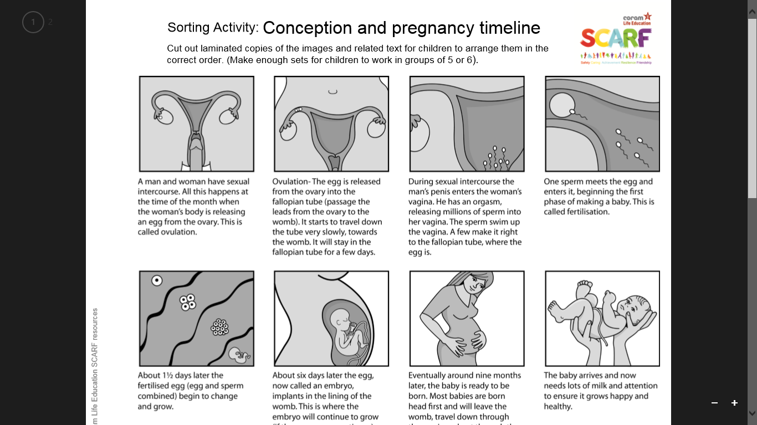
This is an example of one of the sheets we will be working through.
Notes:
Year 6

Slide 13
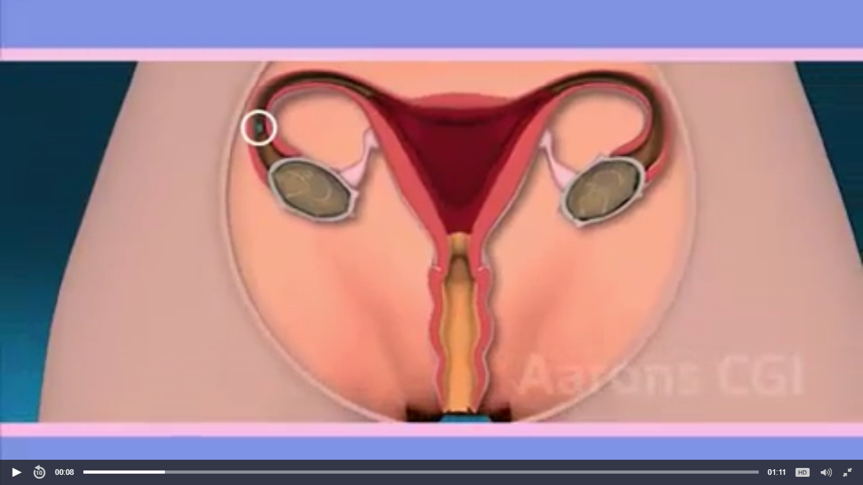
Making babies (coramlifeeducation.org.uk)
Notes:
https://www.coramlifeeducation.org.uk/scarf/lesson-plans/making-babies-1
Making babies (coramlifeeducation.org.uk)

Slide 14

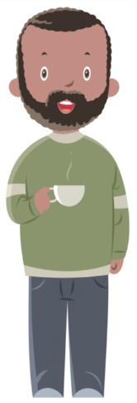

Our role as parents
Parents (and carers) are the prime educators for children on …these matters. Schools complement and reinforce this role…building on what pupils learn at home...
Notes:
Spend some time looking at how we can support you to support your children

Slide 15
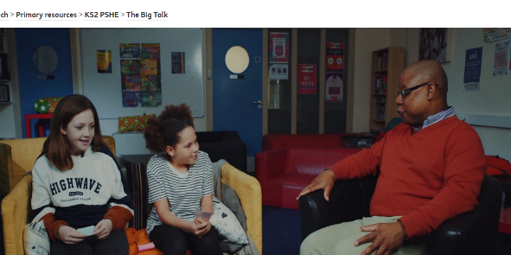

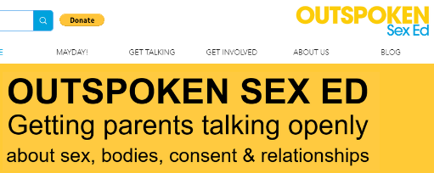
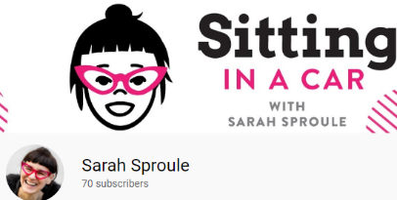
BBC Teach- The Big Talk
Amaze Junior
Sarah Sproule
Outspoken Sex Ed

