Slide 1

Keeping Your children safe online
Agenda
17th October 2023
How we keep children safe at school (RC)
Why we are holding a parents’ meeting – recent incidents (RC)
How we teach children about keeping safe and being respectful online (CP)
Particular apps and dangers to be aware of (JR)
Where to go for further advice (ES)
Thanks and close (RC)

Slide 2




But it doesn’t happen with children round here…
Sadly it does. These are last year’s main culprits:
This Photo by Unknown Author is licensed under CC BY-SA

Slide 3

How do we keep children safe at Bleasby school?
MITRE IT
Filtering
Monitoring
Supervision
Reminders when going online
Specific teaching of internet safety and respectful behaviour

Slide 4



Teaching Internet Safety regularly

Slide 5
Online safety is embedded in the computing curriculum across all years. We also explore online safety as a whole school on Safe Internet Day. This year’s focus was ‘Want to talk about it?’
Computing Scheme of Work (Purple Mash) | Media literacy and digital resilience
Year 1 | Safe logins. Technology outside school.
Year 2 | Searching and sharing. Email. Digital footprint.
Year 3 | Safe passwords. Fact or fiction? Appropriate content and ratings. Using email safely.
Year 4 | Phising. Malware. Plagerism. Screen time.
Year 5 | Responsibilities and support online. Protecting privacy. Reliability.
Year 6 | Messaging in a game. Online behaviour. Screen time.
National Curriculum for Computing
KS1
use technology safely and respectfully, keeping personal information private; identify where to go for help and support when they have concerns about content or contact on the internet or other online technologies
KS2
use technology safely, respectfully and responsibly; recognise acceptable/unacceptable behaviour; identify a range of ways to report concerns about content and contact

Slide 6
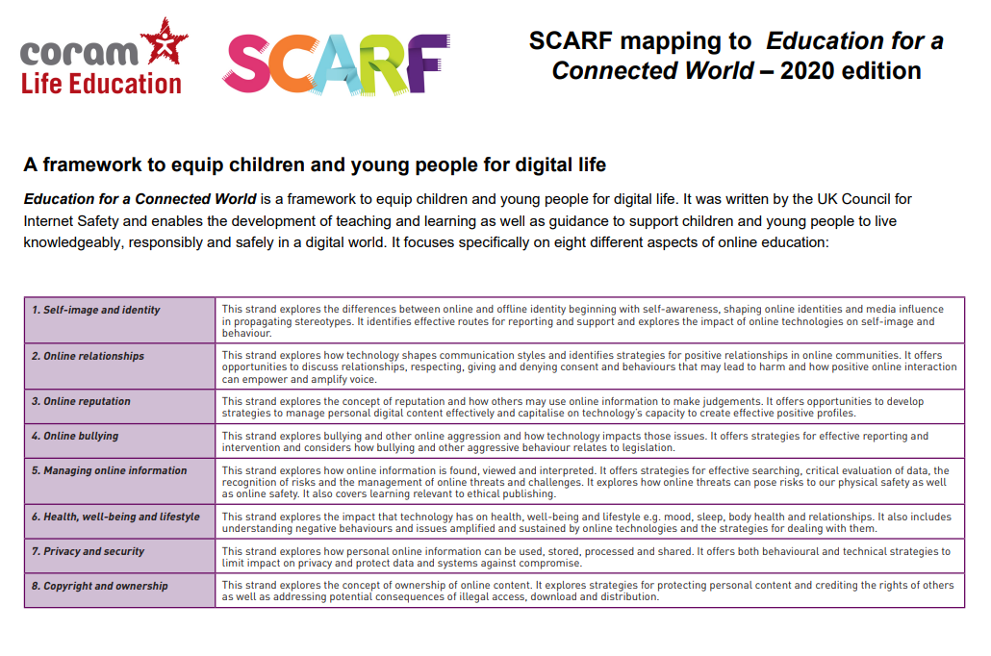
As part of our teaching in RSHE, using the SCARF programme resources, we include a range of lessons about keeping safe online and equipping children for digital life.

Slide 7

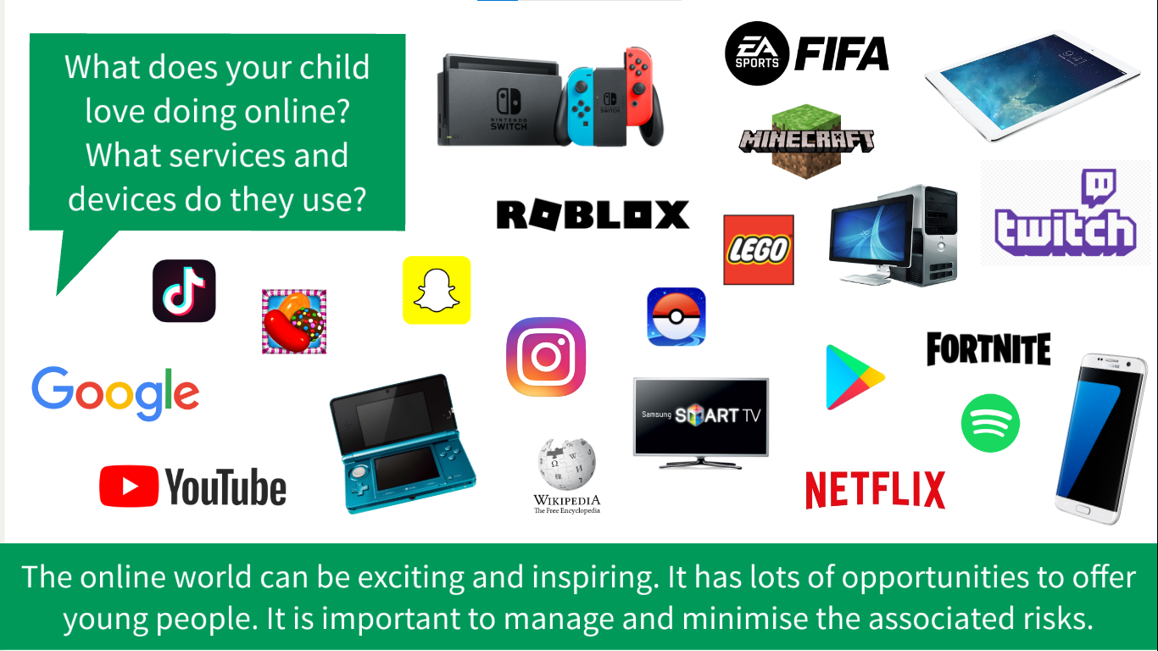

Slide 8
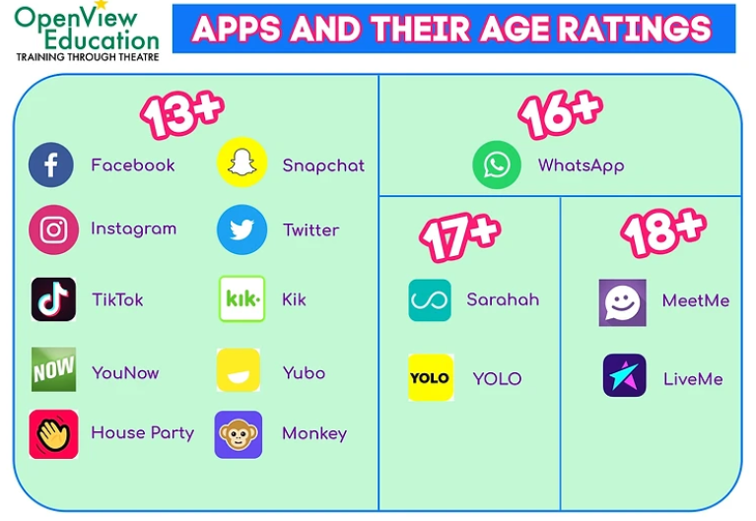

How many children have one or more of these apps?
Why do apps have age limits?
Some apps have a minimum age due to the content that is on them, this could be violent or upsetting, and by putting a false age children could be exposed to something that can be scary or harmful to them.
The social media apps also have age limits as children of primary school age, do not have the emotional maturity or effective online communication skills to be using them. Whatsapp groups were a particular issue in Y6 last year.

Slide 9


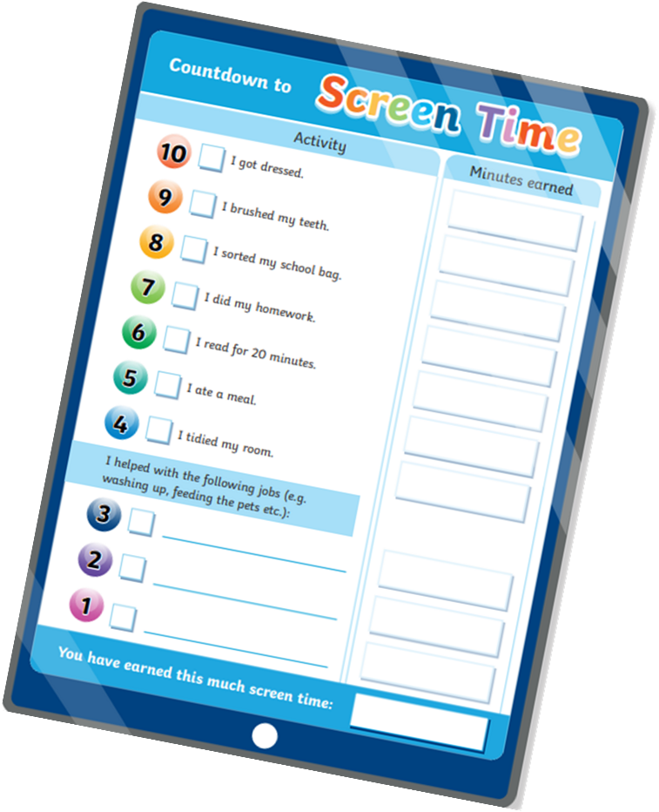
What parents can do at home?
Be aware of what your child is doing online.
Know what apps they have. Encourage use of age-appropriate apps e.g. YouTube kids.
Know who your children are the chatting to.
Limit screen time.
Set up downtime limits.
Keep phones out of bedrooms.
Talk to your children about the potential dangers online and make it clear that they must come to you with anything that makes them feel uncomfortable.
Learn to set restrictions in apps such as turning off location services.
Example
https://nationalonlinesafety.com/hub/view/guide/tiktok-2022

Slide 10
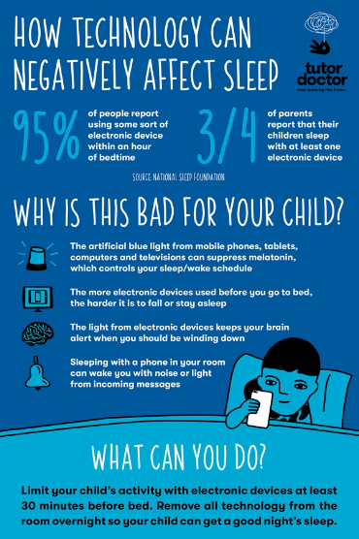
Why is it important to reduce screen time.
It improves physical health.
Improves sleep patterns.
Playing with friends in real life,
Reduces stress and improves mood.

Slide 11
Where to get advice. some useful websites to visit.
https://www.childnet.com/
https://www.internetmatters.org/resources/apps-guide/
https://nationalonlinesafety.com/
https://www.nspcc.org.uk/keeping-children-safe/online-safety/
https://www.gov.uk/government/publications/child-safety-online-a-practical-guide-for-parents-and-carers/
https://saferinternet.org.uk/

Slide 12
Reporting inappropriate contact online.
Visit CEOP website - Child Exploitation and Online Protection
Here you will find guidance about how to report worrying behaviour. Examples of concerns that children have been reported include:
Someone online has asked me to send them nude images.
I shared a nude image with someone online and they are threatening me.
I did something that I was embarrassed about on webcam and someone has turned nasty towards me.
Someone I don't know is asking me to live-stream and do things I don't want to do.
Someone online kept asking me to meet them face-to-face and I feel pressured by them.
Someone online was talking to me about sex and it made me feel uncomfortable.
Someone online is putting pressure on me to do things I don't want to do.
Someone I met in an online game keeps trying to talk to me privately.
https://www.ceop.police.uk/safety-centre/

Slide 13
Thank you for listening
Start the conversation with your children.
Be aware of what your children are accessing.
Be aware of who your children are talking to/in groups with.
Keep the conversation going – make sure your children would tell you!

