Slide 1
Phonics Parent Information Session
Nicky Blacknall
Phonics Lead

Slide 2
Phonics at Bleasby
All children in Orchard have a daily phonics lesson – method of teaching reading and writing (letter-sounds, letter formation, blending to read, segmenting to spell).
Terminology: Phoneme – single sound. Grapheme – letter/s that make the sound. Digraph – 2 letters making 1 sound e.g. ck, ch, sh. Trigraph – 3 letters making 1 sound e.g. igh.
It is a Government recommendation that schools should follow a validated SSP.
Phonics Audit.
Strengths – experienced staff, engaged children, good results across KS1.
Areas to improve – consistent approach, consistent resources.
Trial of schemes.

Slide 3
Rocket Phonics
Next generation phonics programme written by Abigail Steel.
Builds upon previous phonics provision.
Combines alphabetic code knowledge and skills with language-rich children’s literature.
Aim – embed phonics in context and support the love of reading and writing from the outset.
Rationale and design – both research and practice informed.

Slide 4
Rocket Phonics
Combination of printed and digital resources.
Fully matched series of decodable reading books.
Digital Big books – consist of language-rich stories to teach all the target letter-sounds in context. Designed to be used on the IWB.
Flashcards – lower-case and upper-case letters, decodable word on the reverse.
Pupil practice booklets – enable children to practice and apply blending and segmenting skills at letter-sound, word, sentence and text levels.

Slide 5
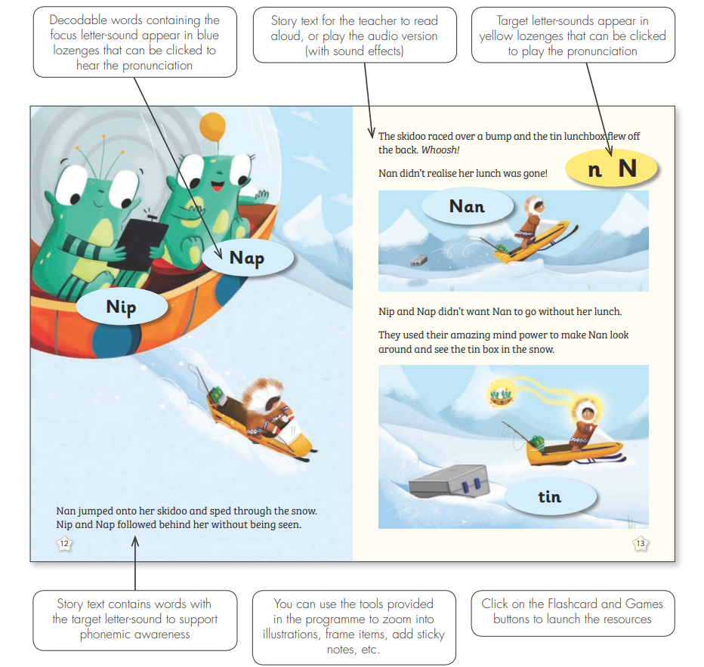

Slide 6
Target Practice Reading Books
Focused practice of small groups of target letter-sounds.
Fully decodable.
Fully aligned with the programme.
Can be used as a whole class, guided group, one to one and independent reading.
Fiction and non-fiction texts.

Slide 7
Rocket Phonics Reading Books
Ideal complement to the programme.
Fully decodable.
Home reading books.
Fully aligned to the programme – to be used as soon as ALL the letter-sounds in a particular colour band have been taught.

Slide 8
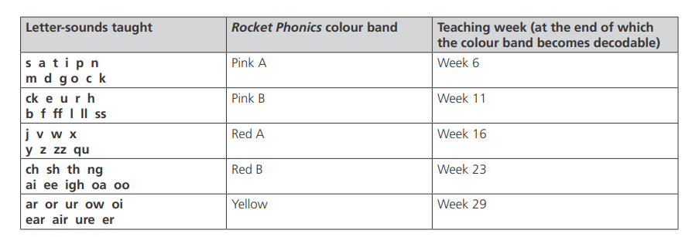

Slide 9
Fundamentals.
All staff to use the Rocket Phonics programme (fully trained and supported).
All reading books to complement the programme.
Phonics is taught for a minimum of 30 minutes each day.
Clear pathway is followed through the alphabetic code.
Children are not asked to read texts by themselves that they can’t yet read.

Slide 10
Fundamentals continued
The teaching and learning cycle (revisit and review, teach, practice, apply) is followed.
Children are supported to keep up, so they do not need to catch up.
Phonics is taught at letter-sound, word, sentence and text levels.
Teachers take ownership and adapt to suit the needs of their children.
Whole class teaching – expose all children to all teaching (differentiated by level of support given and expected outcome).
Designed to be ambitious & challenging.

Slide 11
Challenge
YR – lessons stretch beyond letter-sound and word levels to include sentence and text level activities. Lessons also include ambitious vocab and word structures. Talking about different spelling choices.
Y1/2 – extension activities with partners, independent practice, self dictation, composition of their own sentences in addition to those dictated. Diligence to accuracy and attention to detail – letter formation, pencil grip. Additional enrichment reading books (95% reading independence). Opportunities for further extension during Guided Reading sessions.

Slide 12
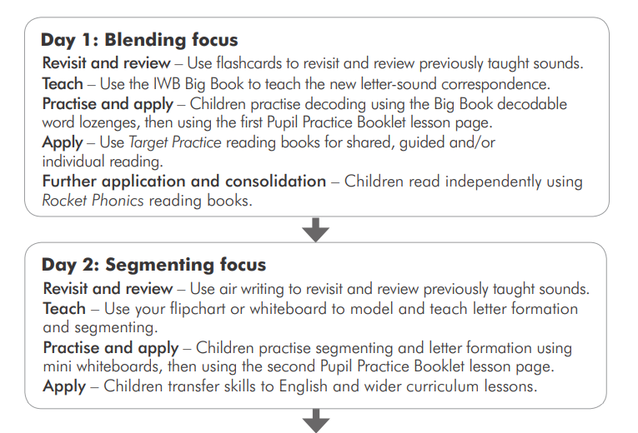

Slide 13
